Slide 1
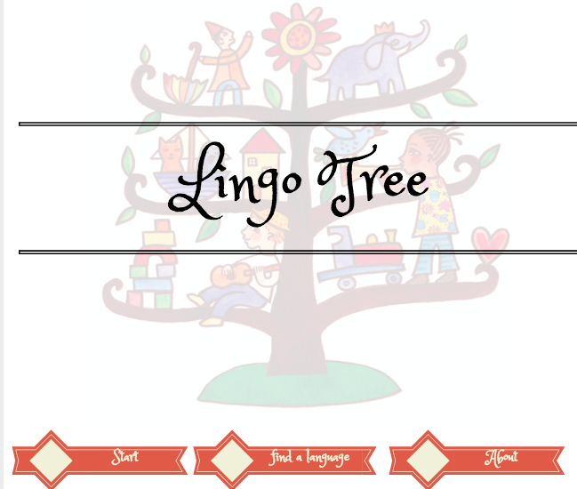
Xiaofan Wu & Yuanzhen Pan
CS 230

Slide 2

real Life Problem:

Slide 3

Or Simply just can’t talk to your grandparents?

Slide 4
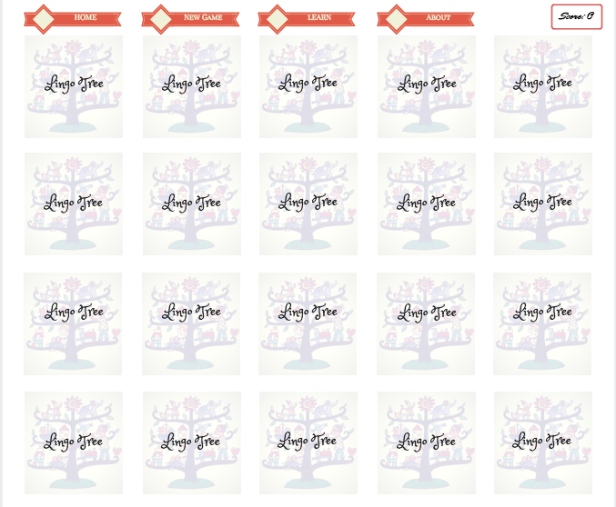
Introducing Lingo Tree!
lingo Tree is here to help!
An interface to learn any language you want! (will have Spanish, Hebrew, and Chinese first)
Learn by playing!
The goal of the game is to match two cards of two different languages from a pile, if the two cards match, they disappear. If not, they will stay in the pile.
Perfect for young children!
No more language barriers!

Slide 5
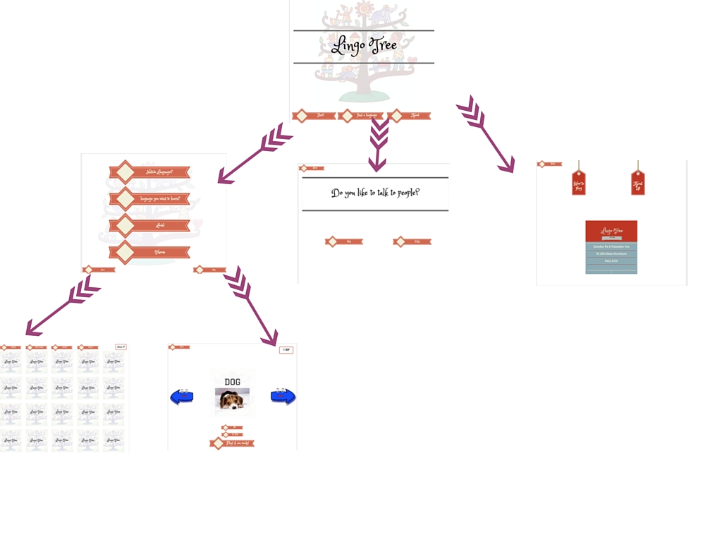
Overview of different pages

Slide 6
Home Page
Start
learn or play
Find a language
help you decide what language
About
how to play the game
about the creators

Slide 7
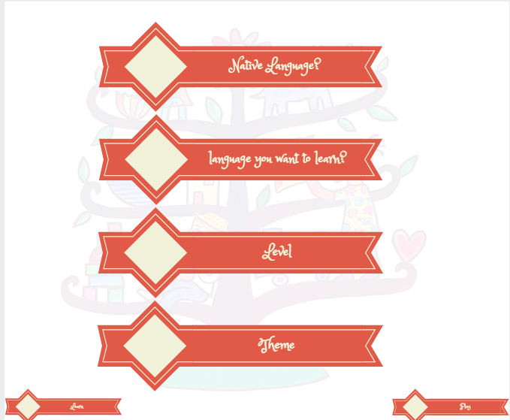
Start page
Settings
Play or Learn
Saved in txt files
Dropdown menus
Listeners

Slide 8
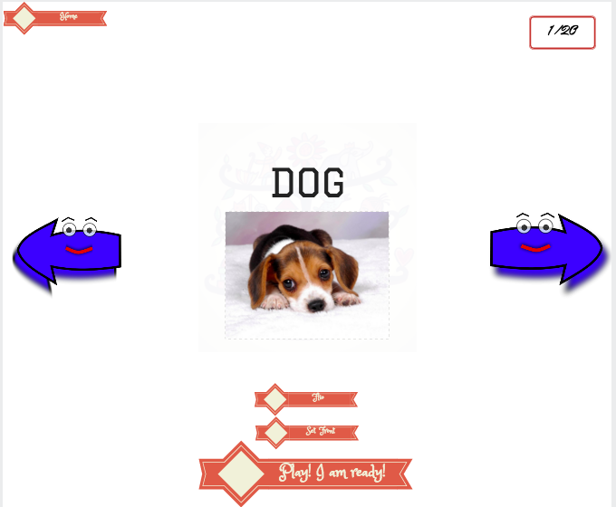
Learn page
Previous or next card
Flip
Set front
Data Structure:
Queue
Methods:
shuffle()
nextCard()
preCard()
addToMemory()

Slide 9
Play Page
Match two cards of different languages.
Win when all the cards disappear.
Data Structure:
Hashtable
Methods:
Check()
takeOut()
flipBack()
score()

Slide 10
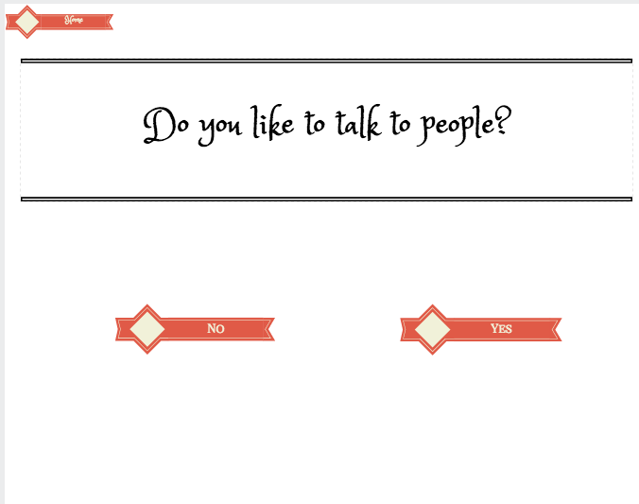
Find a language Page
Figure out a language to learn
Data Structure:
decision tree
yesOrNo()

Slide 11
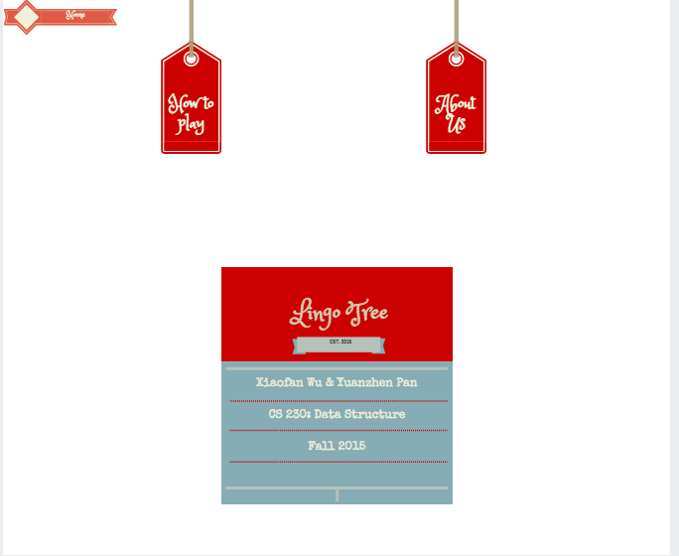
About page
How to play?
display text
Who we are?
display image
Uses:
Button listeners

Slide 12
Overview of different pages Again: Notice Anything?????

Slide 13

Challenges
Connecting user interface with data structure used
Figure out the flip action

Slide 14

Thank you :D

